Slide 1
REDEMPTION: Real-Time Protection Against Ransomware at End-hosts
Instructor: Dr. Kyu Hyung Lee
Presented By:
Omkar Acharya
Akshay Jagtap

Slide 2
CONTENT
Introduction
Background
Why Protect Systems ?
Abstract
Problem Statement
Our Work
WDK and Windows SDK
File System Filter Driver
Fast I/O Handler
IRP File Filter Driver
Minifilter Driver
Demo- Attack simulation
References
Questions

Slide 3
INTRODUCTION
Ransomware is a form of extortion, where system is locked
Victim pays the demanded payment to unlock the system
Enters a system via network services or downloaded files.
Every 40 seconds, a Company gets hit with a Ransomware
Types of Ransomware : Scareware, Screen Locker, Encrypting Ransomware

Slide 4
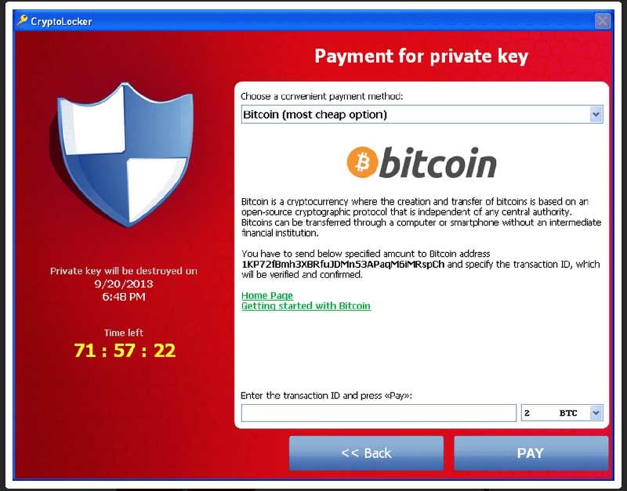
Contd..
This is how Ransomware Attack looks like:
[Image Source: http://cdn2.techadvisor.co.uk/cmsdata/features/3635730/cryptolocker-ransomware.jpg]

Slide 5
HISTORY TO RANSOMWARE ATTACK
First known Ransomware attack “AIDS Trojan” was in 1989,
Became notable in mid 2006, Trojan such as Gp-code, Archiveus, Krotten, Cryzip.
In Late 2013, Bitcoin digital currency provoked more ransomware attacks.
Over $27 Million Dollars where extorted by the attackers
More than 2,00,000 systems were affected by WanaCry ransomware attack in May, 2017

Slide 6
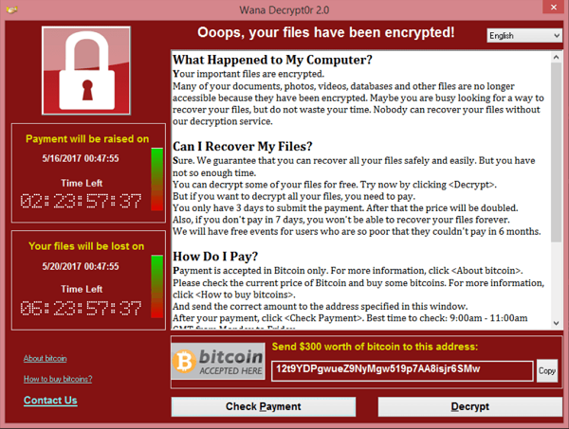
Contd..
WanaCry Ransomware Sample :
[Image Source: https://upload.wikimedia.org/wikipedia/en/1/18/Wana_Decrypt0r_screenshot.png]

Slide 7
WHY PROTECT SYSTEM?
Ransomware affects IT sectors including Finance, Health, Manufacturing firms
To reduce the vulnerability of the system to cyber attacks
It can cause huge economical loss to the organization
Only 21 percent say their current anti-malware solution is completely effective

Slide 8
ABSTRACT
Ransomware is a form of malware which blocks user’s access to the data on his computer.
Increasing number of attacks has resulted into a need for a full-proof solution against this malware.
Redemption is a robust defence mechanism
It makes OS more strong to Ransomware attacks.
Monitors the application request patterns

Slide 9
PROBLEM STATEMENT
Ransomware attack can refrain user from using his/her system
All the sensitive user data is encrypted by attacker’s code
Ransom amount is dependent on attacker’s will
This can affect in stagnancy of operations in Organization
Limiting and monitoring of such attacks is necessary
Better security measures and timely system updates
Use of effective malware detection techniques

Slide 10
OUR WORK
Enabled Windows Driver kit in Microsoft Visual Studio 17
Developed File System Filter Driver
Loaded the driver using driver loading tool
Captured Debug View
Simulated Ransomware attack ( Wanacry 2.0 Sample)

Slide 11
WDK AND Windows SDK
It provides support for windows driver development
Multiple support for windows libraries
Gives ability to develop for KMDF, WDM, UMDF for driver design

Slide 12
FILE SYSTEM FILTER DRIVER
It interacts with the given targeted disk volume
Attaches volumes as device object for filter functions
Filter manager finds number of volumes to be attached
Monitors operations on the device objects
Any modification to file is captured in the debugview

Slide 13
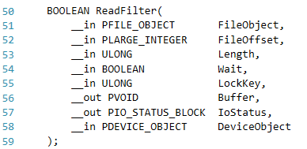
FILE SYSTEM FILTER STRUCTURE

Slide 14
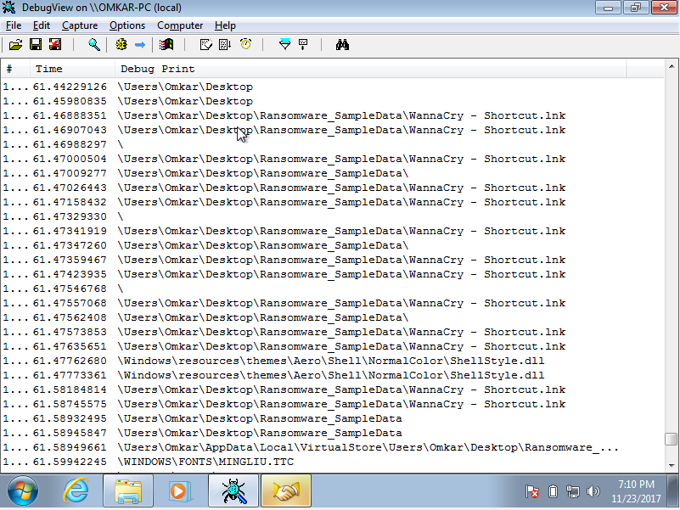
Fig: Legacy File System Filter Driver Output

Slide 15
FAST I/O HANDLER
A special feature which enables direct entry to driver stack run flow
Maps file residing on the disk volume
Uses windows caches depending on the size

Slide 16
IRP FILE FILTER DRIVE
IRP stands for I/O Request Packet.
I/O Manager creates IRP’s to store information related to I/O operations.
IRP’s are default means to perform IO operations

Slide 17
MINIFILTER DRIVER
It has embedded file manager to interact with kernel
Loads at the entry point of file filter driver
It can perform both IRP based or Fast I/O based Filter callback operations
Can choose between type of file I/O operations
Post operation and Pre operation
Includes INF file for its start type definition

Slide 18
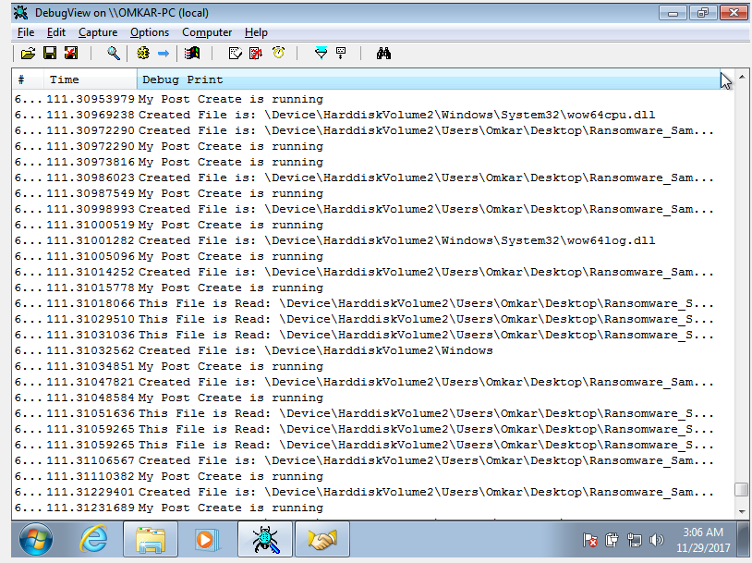
Fig.: Minifilter File Filter Driver Output

Slide 19
Demo

Slide 20
LIMITATIONS
User still not able to get notified about attack
No automatic cease of the attack operation
No sufficient developer liberties provided by Microsoft
Complexity rises when it comes to revive Windows Kernel mode development

Slide 21
REFERENCES
https://docs.microsoft.com/en-us/windows-hardware/drivers/ifs/irps-are-different-from-fast-i-o
https://docs.microsoft.com/en-us/windows-hardware/drivers/kernel/introduction-to-device-objects
https://docs.microsoft.com/en-us/windows-hardware/drivers/kernel/handling-irps
Redemption: Real-Time Protection against Ransomware At End-Hosts [Amin Kharraz1 and Engin Kirda1 {mkharraz,ek}@ccs.neu.edu Northeastern University, Boston, USA]
https://github.com/apriorit/file-system-filter/blob/master/readme.md
https://docs.microsoft.com/en-us/windows-hardware/drivers/kernel/overview-of-the-windows-i-o-model
https://msdn.microsoft.com/en-us/library/windows/hardware
https://mega.nz/#!BSJjWaIL!a2or0xzGJaS0CxCHri0cLwS4LFhqQQrTKotFro7hWQk – Online Ransomware Sample
https://github.com/Microsoft/Windows-driver-samples
https://www.youtube.com/watch?v=ukUf3kSSTOU
https://docs.microsoft.com/en-us/windows-hardware/drivers/ifs/file-system-minifilter-drivers

Slide 22
Questions

